Slide 1

UKACM-SEMNI Autum School
Lecture 2: Fourier and Graph Neural Operators
Dr Burigede Liu
University of Cambridge
Email: BL377@cam.ac.uk

Slide 2
Overview
Fourier transform – basics
Fourier layer and Fourier Neural Operator
Graph basics
Graph Neural Operator

Slide 3
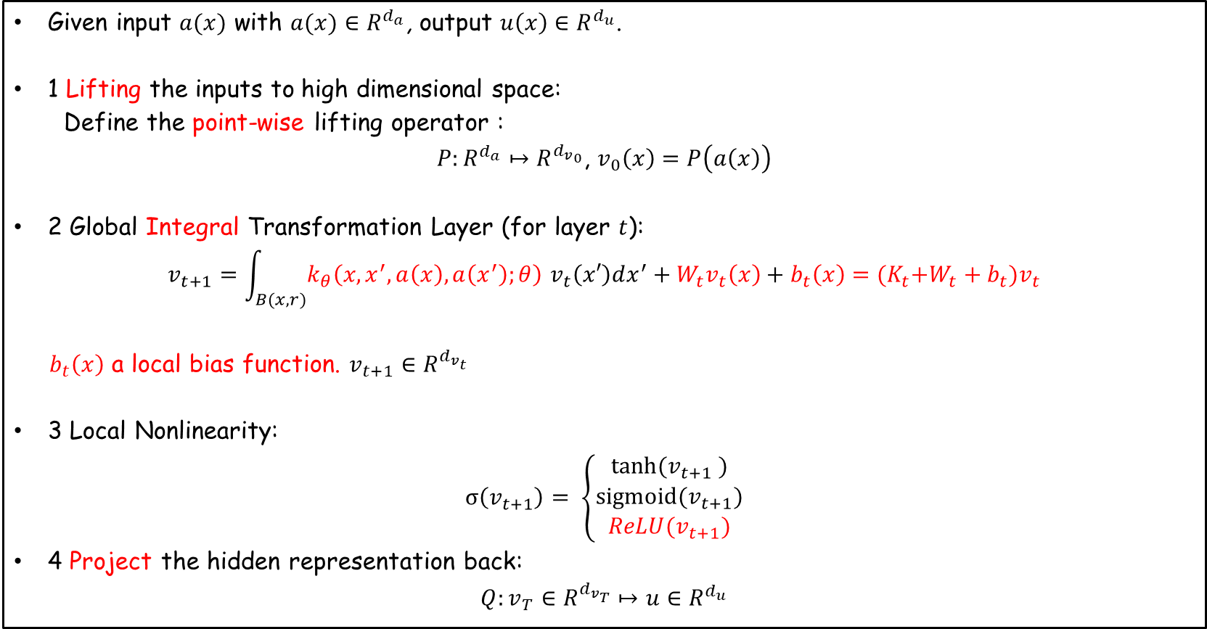
Recall from last lecture
Architecture for a T layer Neural Operator
Given input $a(x)$ with $a(x)∈R^{d_{a}}$, output $u\left(x\right)∈R^{d_{u}}$.
1 Lifting the inputs to high dimensional space:
Define the point-wise lifting operator :
$P:R^{d_{a}}↦R^{{d_{v}}_{0}}$, $v_{0}\left(x\right)=P\left(a\left(x\right)\right)$
2 Global Integral Transformation Layer (for layer $t$):
$$v_{t+1}=\int_{B(x,r)}{k_{θ}\left(x,x^{′},a\left(x\right),a\left(x^{′}\right);θ\right) v_{t}\left(x′\right)dx^{′}}+W_{t}v_{t}\left(x\right)+b_{t}\left(x\right)={(K}_{t}{+W_{t}+b}_{t})v_{t}$$
$b_{t}\left(x\right)$ a local bias function. $v_{t+1}∈R^{d_{v_{t}}}$
3 Local Nonlinearity:
$$σ\left(v_{t+1}\right)= \left\{\begin{aligned}tanh⁡(v_{t+1} ) \\ sigmoid(v_{t+1}) \\ ReLU(v_{t+1})\end{aligned}\right.$$
4 Project the hidden representation back:
$$Q:v_{T}∈R^{d_{v_{T}}}↦{u∈R}^{d_{u}}$$

Slide 4
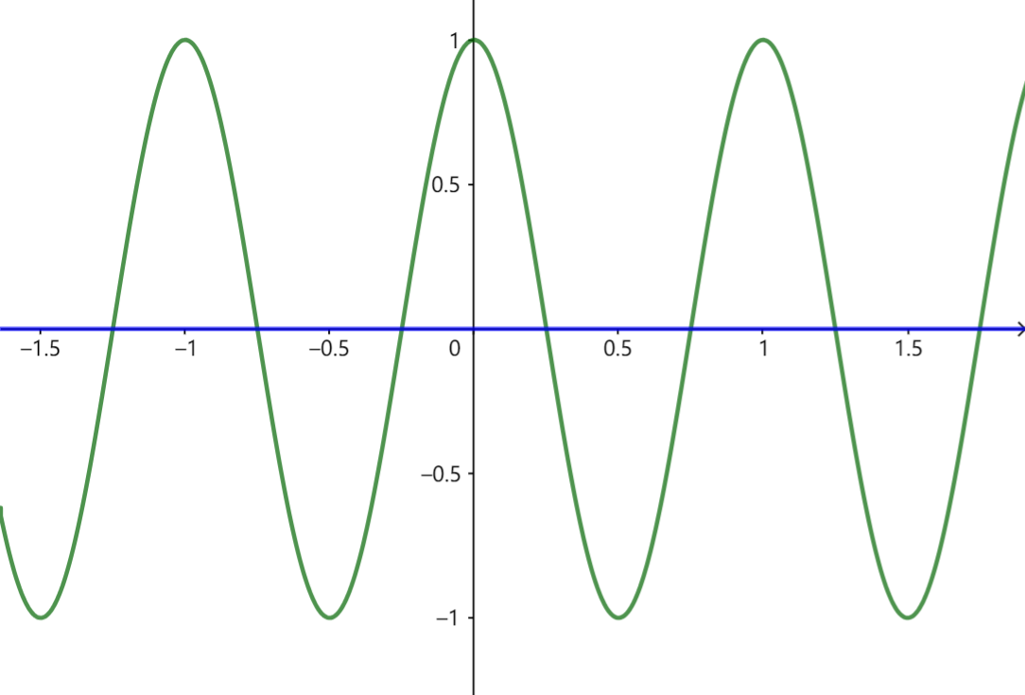
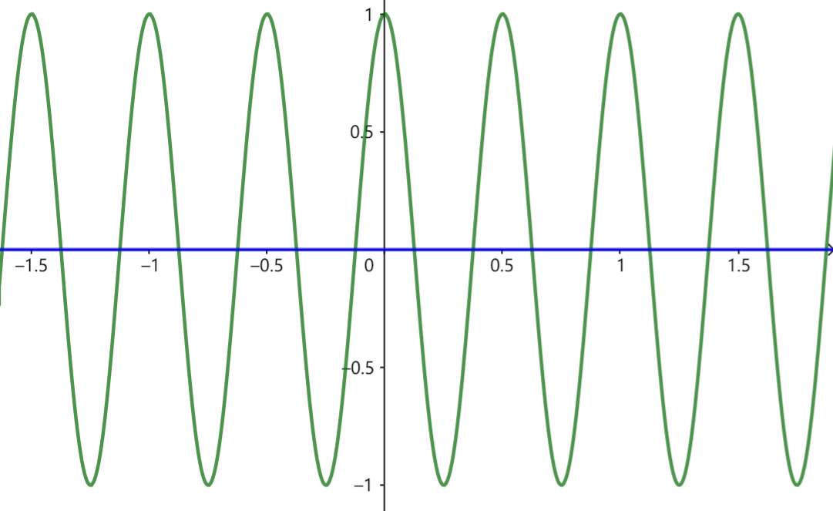
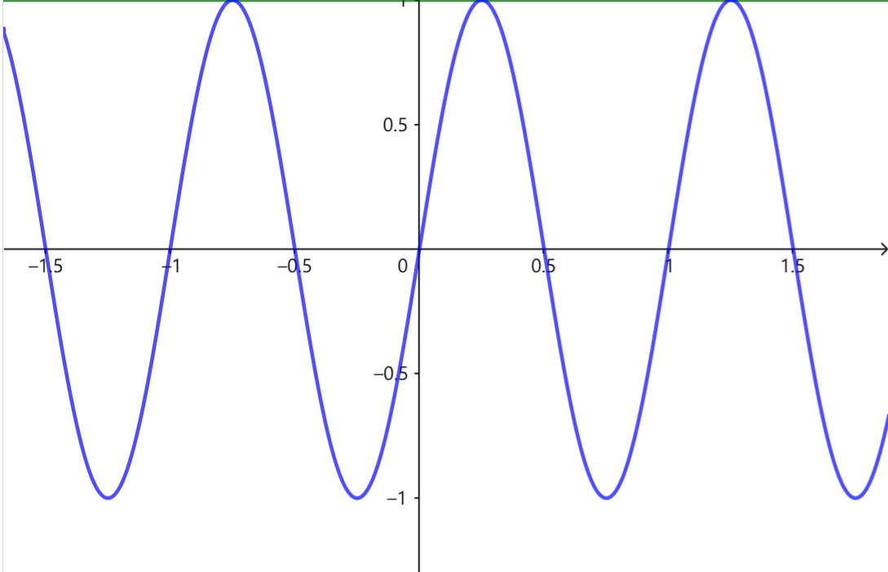
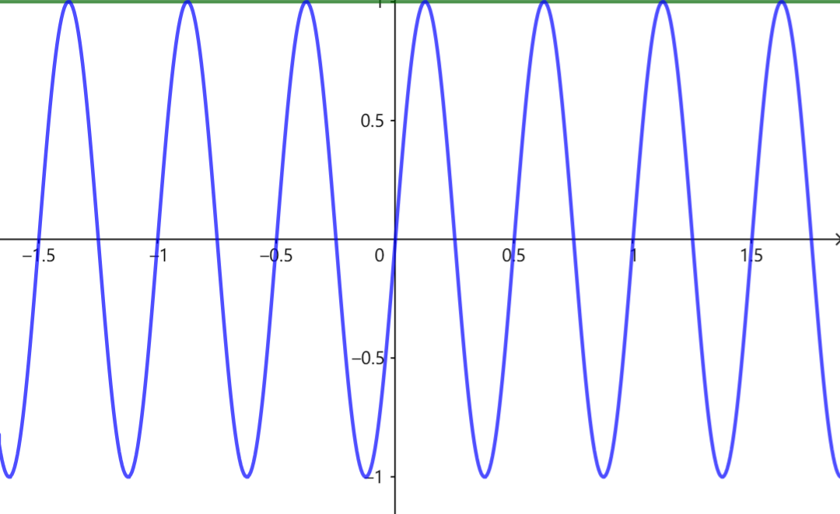
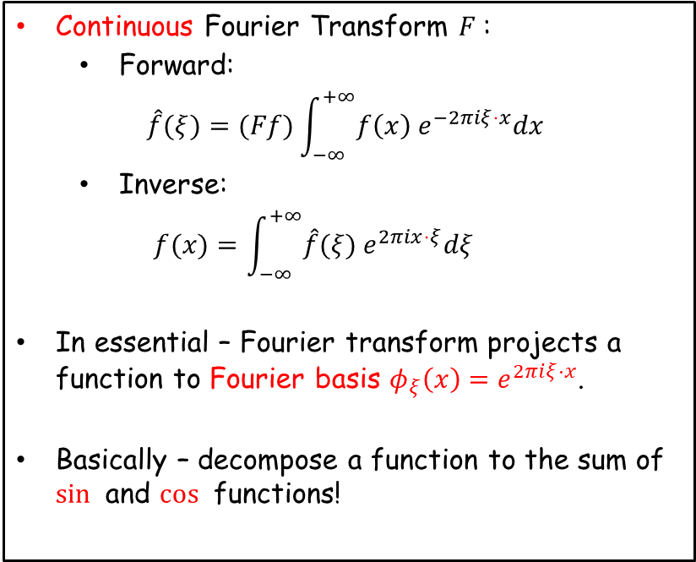
Convolution operator $K_{t}$
A tricky term to compute $O(N^{2})$
$$\int_{Ω}{k_{θ}\left(x,x^{′},a\left(x\right),a\left(x^{′}\right);θ\right) v_{t}\left(x′\right)dx^{′}}=K_{t}v_{t}$$
Recall Fourier Transform
Example – 1D Fourier basis
Real part
Continuous Fourier Transform $F$:
Forward:
$$\hat{f}(ξ)=(Ff)\int_{−∞}^{+∞}{f\left(x\right) e^{−2πiξ⋅x}dx}$$
Inverse:
$$f(x)=\int_{−∞}^{+∞}{\hat{f}(ξ) e^{2πix⋅ξ}dξ}$$
In essential – Fourier transform projects a function to Fourier basis ${φ_{ξ}\left(x\right)=e}^{2πiξ⋅x}$.
Basically – decompose a function to the sum of $sin⁡$ and $cos⁡$ functions!
Imaginary part

Slide 5
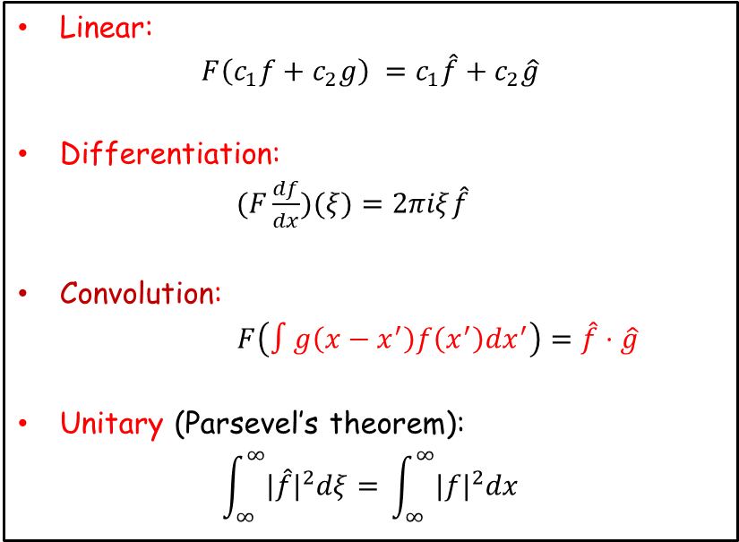
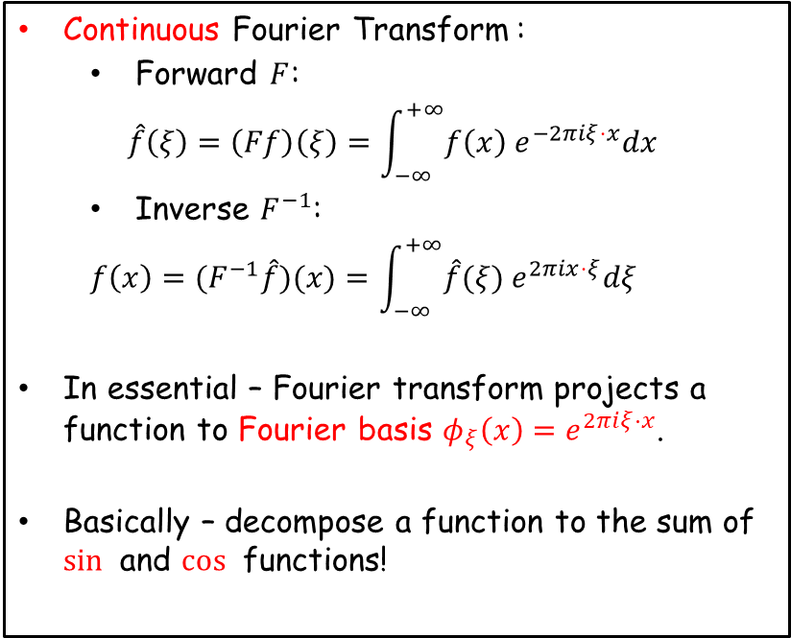
Convolution operator $K_{t}$
A tricky term to compute $O(N^{2})$
$$\int_{Ω}{k_{θ}\left(x,x^{′},a\left(x\right),a\left(x^{′}\right);θ\right) v_{t}\left(x′\right)dx^{′}}=K_{t}v_{t}$$
Recall Fourier Transform
Property
Continuous Fourier Transform :
Forward $F$:
$$\hat{f}\left(ξ\right)=\left(Ff\right)\left(ξ\right)=\int_{−∞}^{+∞}{f\left(x\right) e^{−2πiξ⋅x}dx}$$
Inverse $F^{−1}$:
$$f\left(x\right)={(F}^{−1}\hat{f})(x)=\int_{−∞}^{+∞}{\hat{f}(ξ) e^{2πix⋅ξ}dξ}$$
In essential – Fourier transform projects a function to Fourier basis ${φ_{ξ}\left(x\right)=e}^{2πiξ⋅x}$.
Basically – decompose a function to the sum of $sin⁡$ and $cos⁡$ functions!
Linear:
$$F\left(c_{1}f+c_{2}g\right) =c_{1}\hat{f}+c_{2}\hat{g}$$
Differentiation:
$(F\frac{df}{dx})(ξ)=2πiξ\hat{f}$
Convolution:
$F\left(∫g\left(x−x^{′}\right)f\left(x^{′}\right)dx^{′}\right)=\hat{f}⋅\hat{g}$
Unitary (Parsevel’s theorem):
$$\int_{∞}^{∞}{{|\hat{f}|}^{2}dξ= }\int_{∞}^{∞}{{|f|}^{2}dx}$$
Good reference: https://www.thefouriertransform.com/

Slide 6
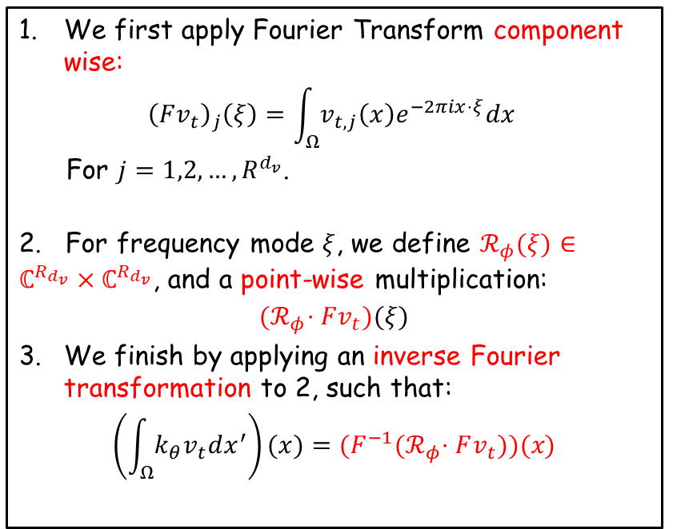
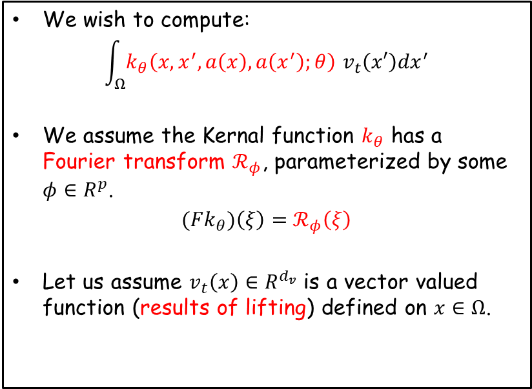
Fourier Neural Operator
Convolution theorem
$$F\left(∫g\left(x−x^{′}\right)f\left(x^{′}\right)dx^{′}\right)=\hat{f}⋅\hat{g}$$
Achieving convolution in Fourier space
We wish to compute:
$$\int_{Ω}{k_{θ}\left(x,x^{′},a\left(x\right),a\left(x^{′}\right);θ\right) v_{t}\left(x′\right)dx^{′}}$$
We assume the Kernal function $k_{θ}$ has a Fourier transform $ℛ_{φ}$, parameterized by some $φ∈R^{p}$.
$(Fk_{θ})\left(ξ\right)=$ $ℛ_{φ}\left(ξ\right)$
Let us assume $v_{t}\left(x\right)∈R^{d_{v}}$ is a vector valued function (results of lifting) defined on $x∈Ω$.
We first apply Fourier Transform component wise:
$${\left(Fv_{t}\right)}_{j}\left(ξ\right)=\int_{Ω}{v_{t,j}\left(x\right)e^{−2πix⋅ξ}dx}$$
For $j=1,2,…,R^{d_{v}}$.
2. For frequency mode $ξ$, we define $ℛ_{φ}(ξ)∈ℂ^{R_{d_{v}}}×ℂ^{R_{d_{v}}}$, and a point-wise multiplication:
$${(ℛ}_{φ}⋅Fv_{t})(ξ)$$
We finish by applying an inverse Fourier transformation to 2, such that:
$$\left(\int_{Ω}{k_{θ}v_{t}dx^{′}}\right)(x)={(F}^{−1}{(ℛ}_{φ}⋅Fv_{t}))(x)$$

Slide 7
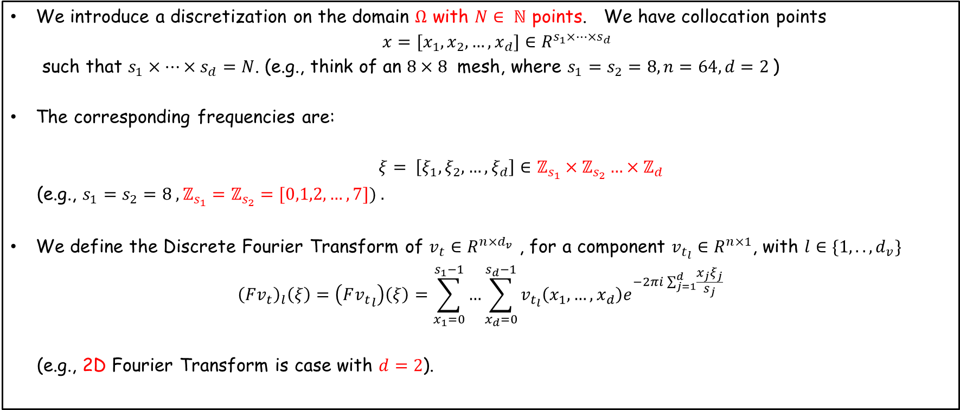
Implementation with Discrete Fourier Transform (2P6)
1. High dimensional DFT
We introduce a discretization on the domain $Ω$ with $N∈ ℕ$ points. We have collocation points
$x=[x_{1},x_{2},…, x_{d}]∈R^{s_{1}×…×s_{d}}$
such that $s_{1}×…×s_{d}=N$. (e.g., think of an $8×8$ mesh, where $s_{1}=s_{2}=8, n=64, d=2$)
The corresponding frequencies are:
$ξ= \left[ξ_{1},ξ_{2},…,ξ_{d}\right]∈ℤ_{s_{1}}×ℤ_{s_{2}}…×ℤ_{d}$
(e.g., $s_{1}=s_{2}=8 ,ℤ_{s_{1}}=ℤ_{s_{2}}=[0,1,2,…, 7]) .$
We define the Discrete Fourier Transform of $v_{t}∈R^{n×d_{v}}$ , for a component $v_{t_{l}}∈R^{n×1}$, with $l∈\{1,..,d_{v}\}$
$${\left(Fv_{t}\right)}_{l}\left(ξ\right)=\left(F{v_{t}}_{l}\right)\left(ξ\right)=\sum_{x_{1}=0}^{s_{1}−1}{…}\sum_{x_{d}=0}^{s_{d}−1}{v_{t_{l}}\left(x_{1},…,x_{d}\right)e^{−2πi\sum_{j=1}^{d}{\frac{x_{j}ξ_{j}}{s_{j}}}}}$$
(e.g., 2D Fourier Transform is case with $d=2$).

Slide 8
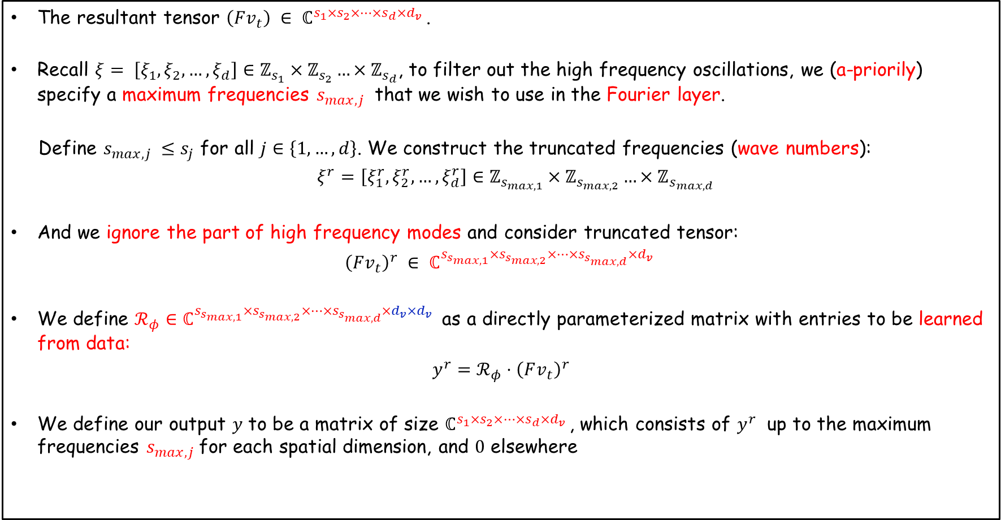
Implementation with Discrete Fourier Transform (2P6)
2. $ℛ_{φ}$ with truncated frequencies
The resultant tensor $\left(Fv_{t}\right) ∈ ℂ^{s_{1}×s_{2}×…×s_{d}×d_{v} }$.
Recall $ξ= \left[ξ_{1},ξ_{2},…,ξ_{d}\right]∈ℤ_{s_{1}}×ℤ_{s_{2}}…×ℤ_{s_{d}}$, to filter out the high frequency oscillations, we (a-priorily) specify a maximum frequencies $s_{max,j}$ that we wish to use in the Fourier layer.
Define $s_{max,j} ≤s_{j}$ for all $j∈\left\{1,…,d\right\}$. We construct the truncated frequencies (wave numbers):
$ξ^{r}=\left[ξ_{1}^{r}, ξ_{2}^{r},…,ξ_{d}^{r}\right]∈ℤ_{s_{max, 1}}×ℤ_{s_{max,2}}…×ℤ_{s_{max,d}}$
And we ignore the part of high frequency modes and consider truncated tensor:
${\left(Fv_{t}\right)}^{r} ∈ ℂ^{s_{s_{max, 1}}×s_{s_{max, 2}}×…×s_{s_{max, d}}×d_{v} }$
We define $ℛ_{φ}∈ℂ^{s_{s_{max, 1}}×s_{s_{max, 2}}×…×s_{s_{max, d}}×d_{v}×d_{v} }$ as a directly parameterized matrix with entries to be learned from data:
$$y^{r}=ℛ_{φ}⋅{\left(Fv_{t}\right)}^{r}$$
We define our output $y$ to be a matrix of size $ℂ^{s_{1}×s_{2}×…×s_{d}×d_{v} }$, which consists of $y^{r}$ up to the maximum frequencies $s_{max,j}$for each spatial dimension, and $0$ elsewhere

Slide 9
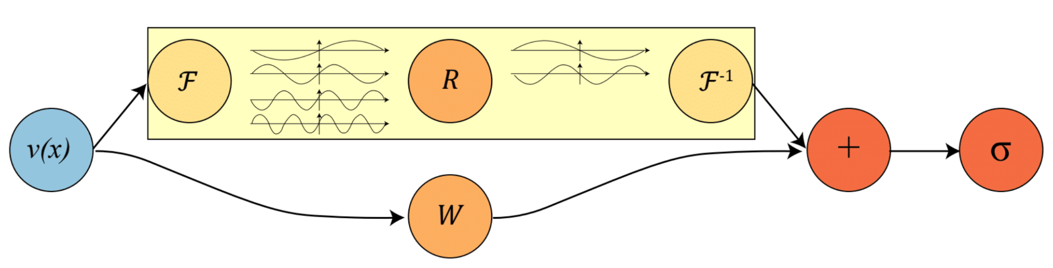
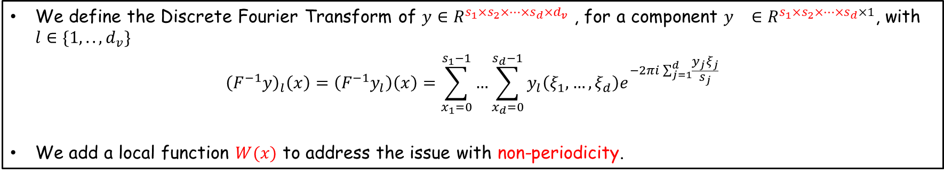
Implementation with Discrete Fourier Transform (2P6)
3. Inverse FFT
We define the Discrete Fourier Transform of $y∈R^{s_{1}×s_{2}×…×s_{d}×d_{v}}$ , for a component $y_{}∈R^{s_{1}×s_{2}×…×s_{d}×1}$, with $l∈\{1,..,d_{v}\}$
$${\left(F^{−1}y\right)}_{l}\left(x\right)=\left(F^{−1}y_{l}\right)\left(x\right)=\sum_{x_{1}=0}^{s_{1}−1}{…}\sum_{x_{d}=0}^{s_{d}−1}{y_{l}\left(ξ_{1},…,ξ_{d}\right)e^{−2πi\sum_{j=1}^{d}{\frac{y_{j}ξ_{j}}{s_{j}}}}}$$
We add a local function $W(x)$ to address the issue with non-periodicity.

Slide 10
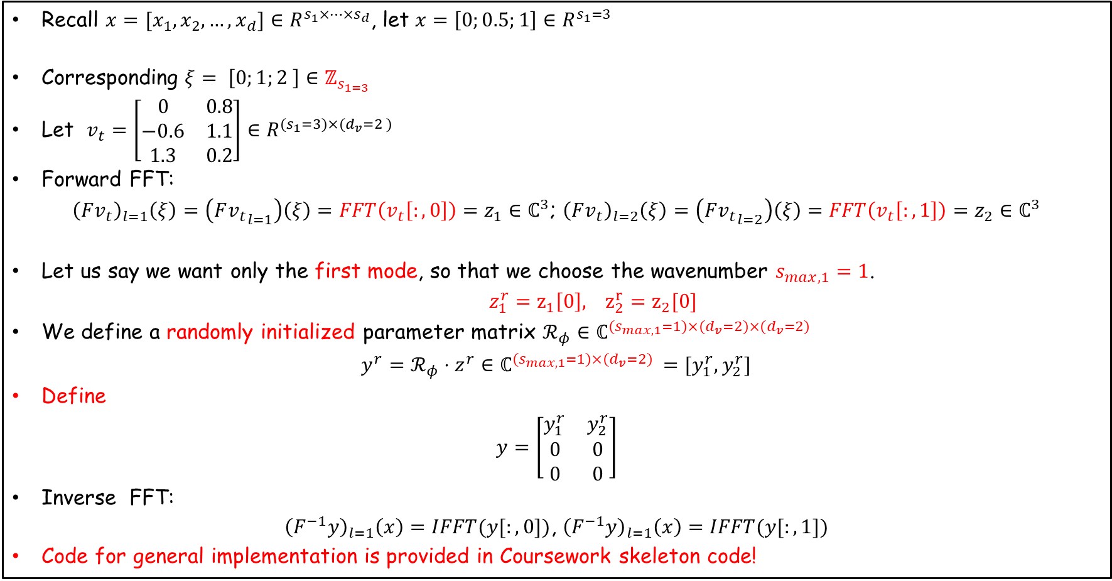
Implementation with Discrete Fourier Transform (2P6)
Example – 1D
Recall $x=[x_{1},x_{2},…, x_{d}]∈R^{s_{1}×…×s_{d}}$, let $x=\left[0;0.5;1\right]∈R^{s_{1}=3}$
Corresponding $ξ= \left[0;1;2 \right]∈ℤ_{s_{1=3}}$
Let $v_{t}=\left[\begin{matrix}0 & 0.8 \\ −0.6 & 1.1 \\ 1.3 & 0.2\end{matrix}\right]∈R^{{(s}_{1}=3)×{(d}_{v}=2 )}$
Forward FFT:
${\left(Fv_{t}\right)}_{l=1}\left(ξ\right)=\left(F{v_{t}}_{l=1}\right)\left(ξ\right)=FFT\left(v_{t}\left[:,0\right]\right)=z_{1}∈ℂ^{3}$; ${\left(Fv_{t}\right)}_{l=2}\left(ξ\right)=\left(F{v_{t}}_{l=2}\right)\left(ξ\right)=FFT\left(v_{t}\left[:,1\right]\right)=z_{2}∈ℂ^{3}$
Let us say we want only the first mode, so that we choose the wavenumber $s_{max, 1}=1$.
$z_{1}^{r}=z_{1}\left[0\right], z_{2}^{r}=z_{2}[0]$
We define a randomly initialized parameter matrix $ℛ_{φ}∈ℂ^{{(s}_{max, 1}=1)×{(d}_{v}=2)×{(d}_{v}=2)}$
$y^{r}=ℛ_{φ}⋅z^{r}∈ℂ^{{(s}_{max, 1}=1)×{(d}_{v}=2) }=[y_{1}^{r}, y_{2}^{r}]$
Define
$y=\left[\begin{matrix}y_{1}^{r} & y_{2}^{r} \\ 0 & 0 \\ 0 & 0\end{matrix}\right]$
Inverse FFT:
${\left(F^{−1}y\right)}_{l=1}\left(x\right)=IFFT(y[:,0])$, ${\left(F^{−1}y\right)}_{l=1}\left(x\right)=IFFT(y[:,1])$
Code for general implementation is provided in Coursework skeleton code!

Slide 11
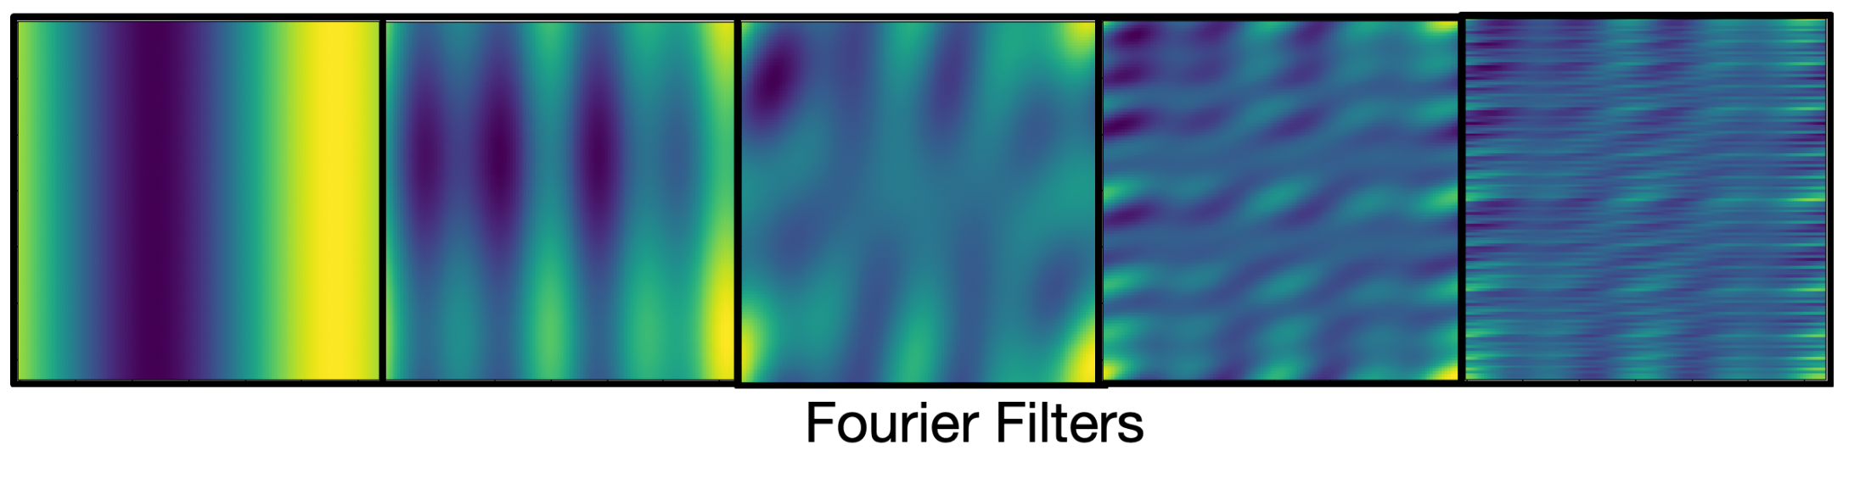
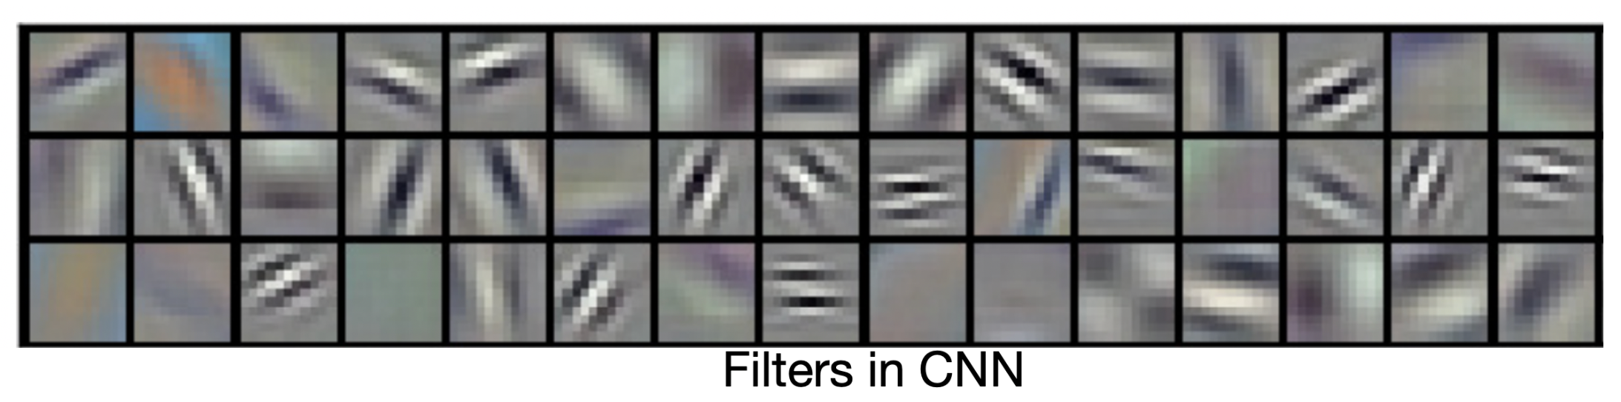
FNO as a global filter
Learned kernel function
Learned matrix

Slide 12
FNO as a global filter
Filters in convolution neural networks are usually local. They are good to capture local patterns such as edges and shapes. Fourier filters are global sinusoidal functions. They are better for representing continuous functions.

Slide 13
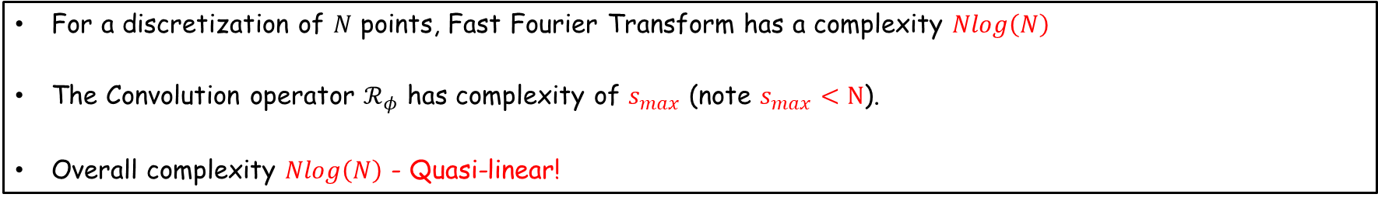
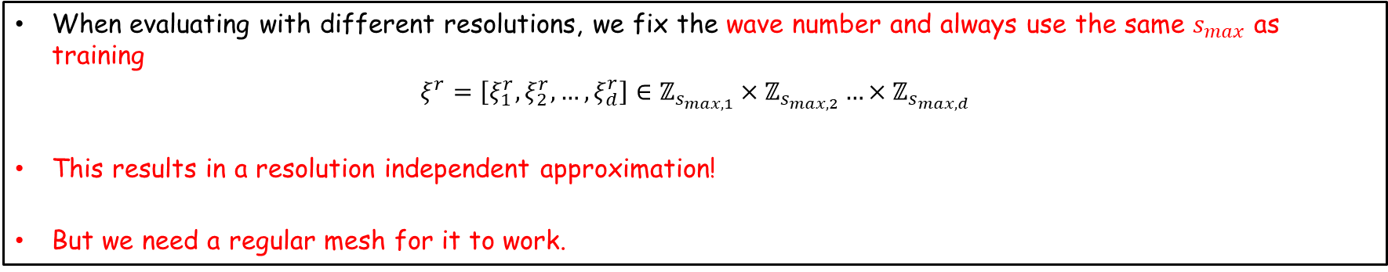
FNO-Complexity
Quasi-linear $Nlog\left(N\right)$
For a discretization of $N$ points, Fast Fourier Transform has a complexity $Nlog\left(N\right)$
The Convolution operator $ℛ_{φ}$ has complexity of $s_{max}$ (note $s_{max}<N$).
Overall complexity $Nlog\left(N\right)$ - Quasi-linear!
FNO-Resolution invariance
Quasi-linear $Nlog\left(N\right)$
When evaluating with different resolutions, we fix the wave number and always use the same $s_{max}$ as training
$$ξ^{r}=\left[ξ_{1}^{r}, ξ_{2}^{r},…,ξ_{d}^{r}\right]∈ℤ_{s_{max, 1}}×ℤ_{s_{max,2}}…×ℤ_{s_{max,d}}$$
This results in a resolution independent approximation!
But we need a regular mesh for it to work.

Slide 14
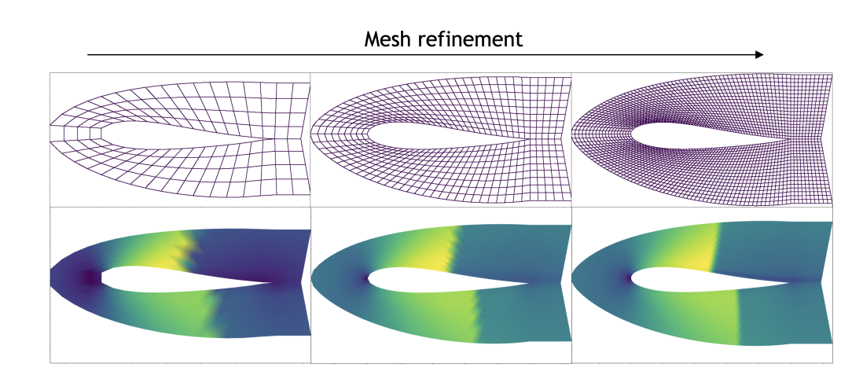
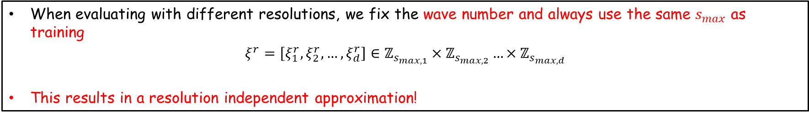
FNO-Resolution invariance
Quasi-linear $Nlog\left(N\right)$
When evaluating with different resolutions, we fix the wave number and always use the same $s_{max}$ as training
$$ξ^{r}=\left[ξ_{1}^{r}, ξ_{2}^{r},…,ξ_{d}^{r}\right]∈ℤ_{s_{max, 1}}×ℤ_{s_{max,2}}…×ℤ_{s_{max,d}}$$
This results in a resolution independent approximation!

Slide 15

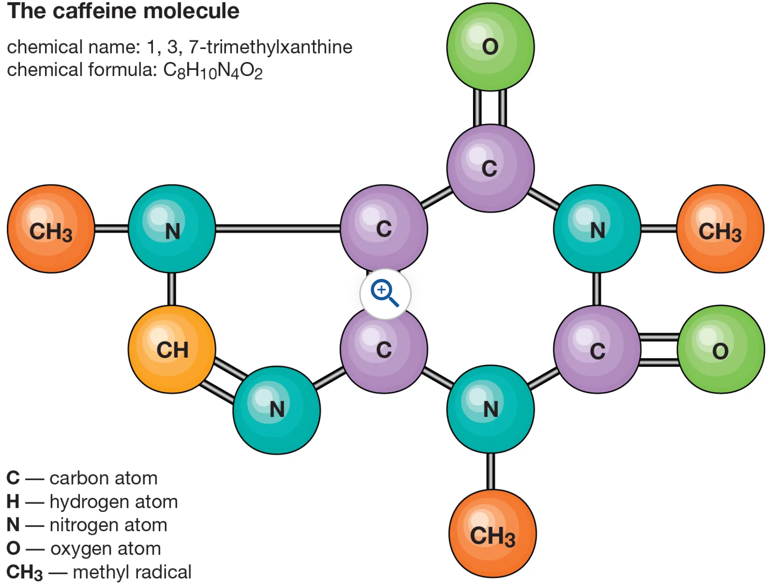
Graph and Graph Neural Network
Graph data
We do not have a regular mesh for many real-life applications.
Chemistry
Social Network

Slide 16
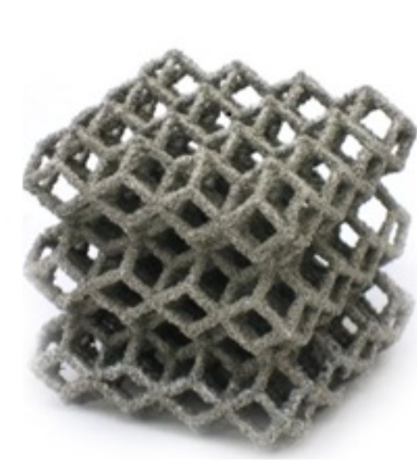

Graph and Graph Neural Network
Graph data
We do not have a regular mesh for many real-life applications.
Architectured material
Un-structured mesh

Slide 17
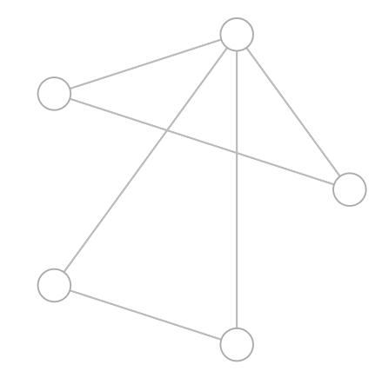
Graph and Graph Neural Network
Graph Basics
A graph represents the relations (edge) between a collection of entities (nodes).

Slide 18
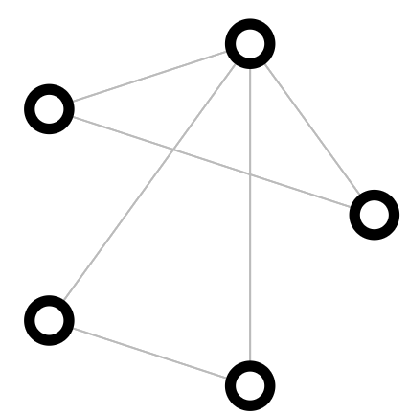
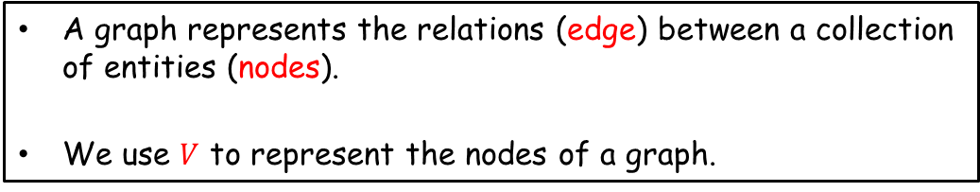
Graph and Graph Neural Network
Graph Basics
A graph represents the relations (edge) between a collection of entities (nodes).
We use $V$ to represent the nodes of a graph.

Slide 19
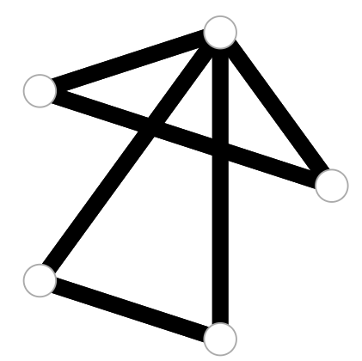

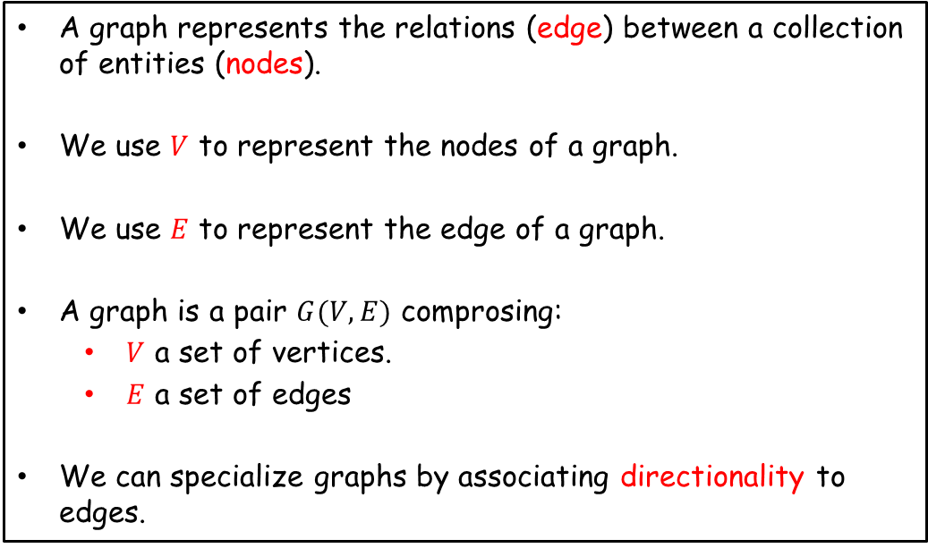
Graph and Graph Neural Network
Graph Basics
A graph represents the relations (edge) between a collection of entities (nodes).
We use $V$ to represent the nodes of a graph.
We use $E$ to represent the edge of a graph.
A graph is a pair $G(V,E)$ comprosing:
$V$ a set of vertices.
$E$ a set of edges
We can specialize graphs by associating directionality to edges.
For a detailed introduction on graph basics:
https://medium.com/basecs/a-gentle-introduction-to-graph-theory-77969829ead8

Slide 20
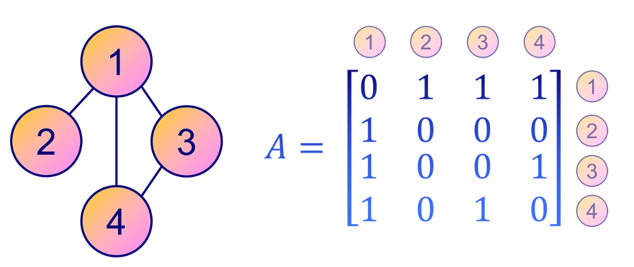
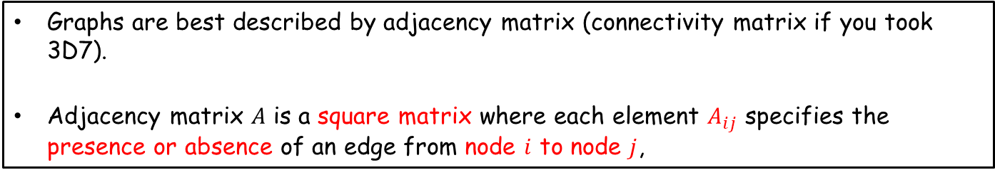
Graph and Graph Neural Network
Adjacency matrix
Graphs are best described by adjacency matrix (connectivity matrix if you took 3D7).
Adjacency matrix $A$ is a square matrix where each element $A_{ij}$ specifies the presence or absence of an edge from node $i$ to node $j$,

Slide 21
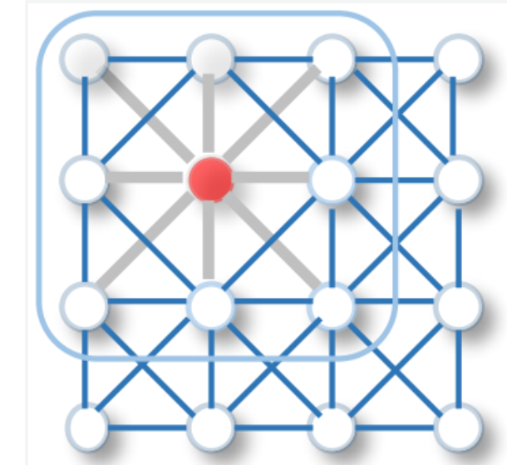

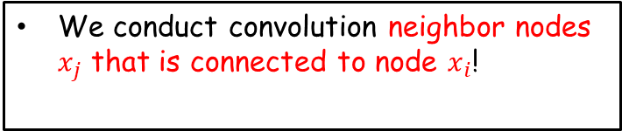
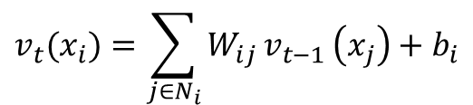
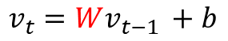
Basic building block - Linear layer
Convolution Layer
Convolution Layer (message passing)
$$v_{t}(x_{i})=\sum_{j∈N_{i}}{W_{ij}}v_{t−1 }\left(x_{j}\right)+b_{i}$$
$$v_{t}=Wv_{t−1 }+b$$
We create a filter that is defined on the neighbors of each nodes.
We conduct convolution neighbor nodes $x_{j}$ that is connected to node $x_{i}$!

Slide 22
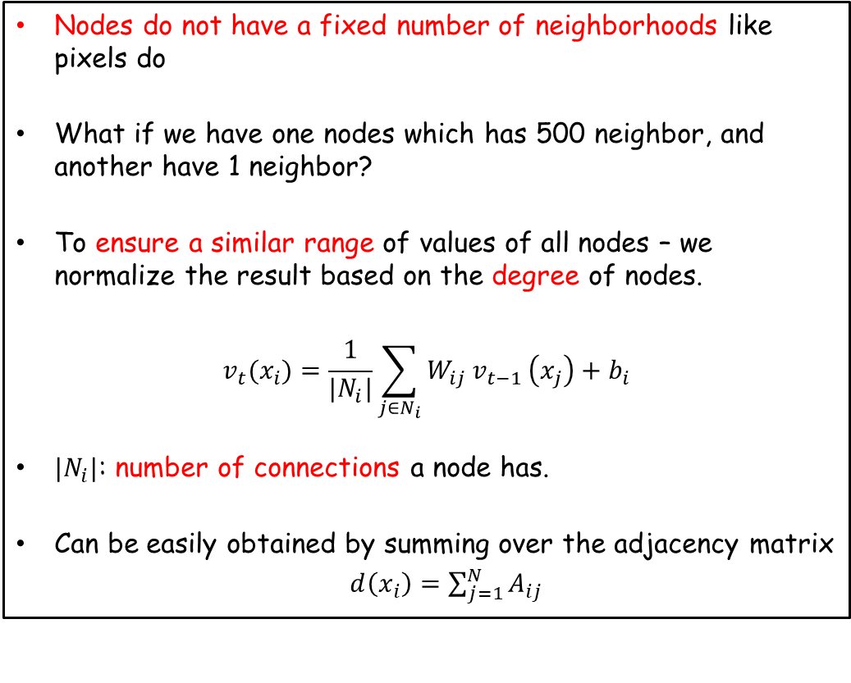

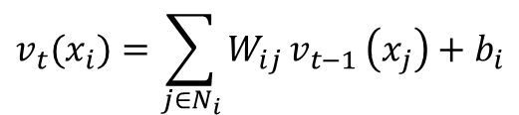
Basic building block - Linear layer
Convolution Layer
Additional trick
Nodes do not have a fixed number of neighborhoods like pixels do
What if we have one nodes which has 500 neighbor, and another have 1 neighbor?
To ensure a similar range of values of all nodes – we normalize the result based on the degree of nodes.
$$v_{t}(x_{i})=\frac{1}{{|N}_{i}|}\sum_{j∈N_{i}}{W_{ij}}v_{t−1 }\left(x_{j}\right)+b_{i}$$
${|N}_{i}|$: number of connections a node has.
Can be easily obtained by summing over the adjacency matrix
$d\left(x_{i}\right)=\sum_{j=1}^{N}{A_{ij}}$
$$v_{t}(x_{i})=\sum_{j∈N_{i}}{W_{ij}}v_{t−1 }\left(x_{j}\right)+b_{i}$$
We conduct convolution neighbor nodes $x_{j}$ that is connected to node $x_{i}$!

Slide 23
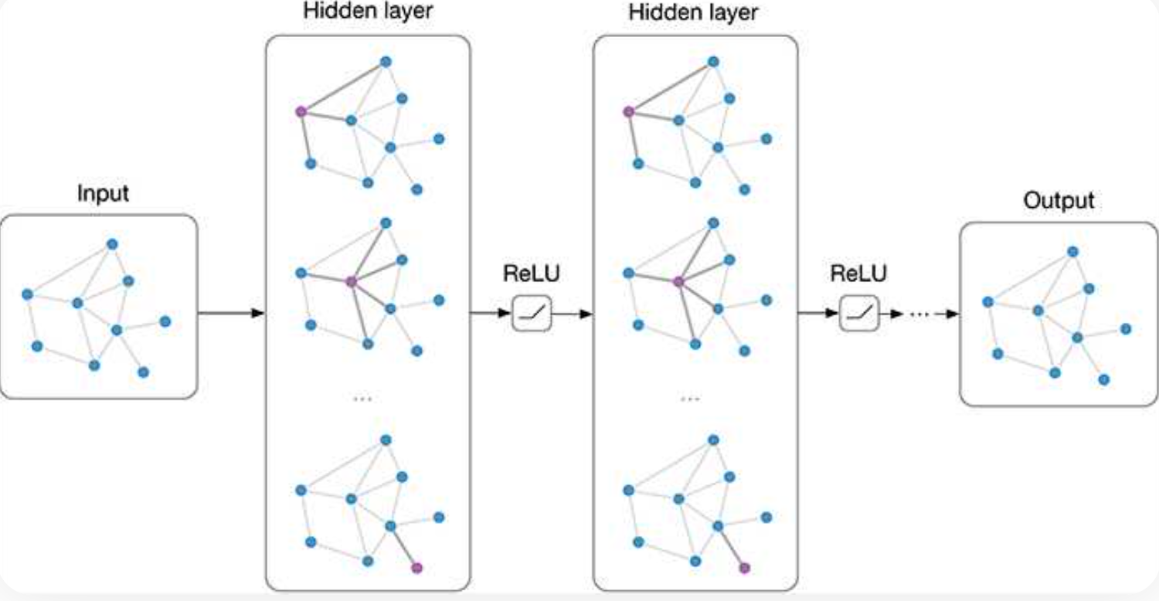
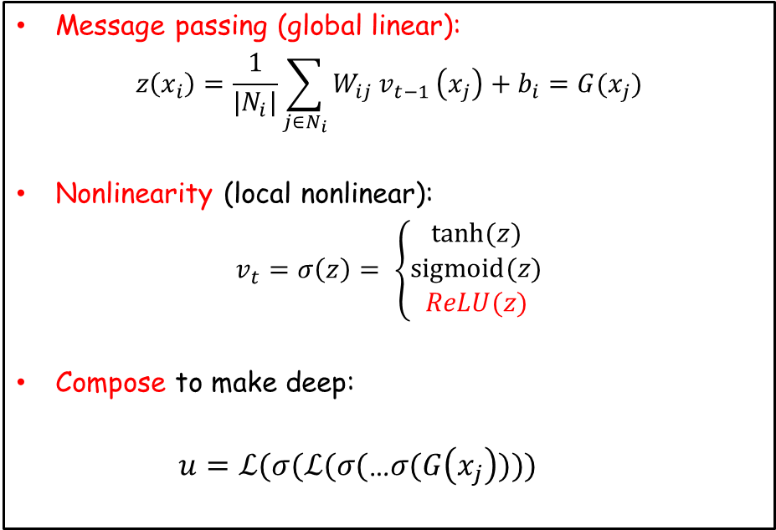
Graph Network
General Architecture
Message passing (global linear):
$$z\left(x_{i}\right)=\frac{1}{{|N}_{i}|}\sum_{j∈N_{i}}{W_{ij}}v_{t−1 }\left(x_{j}\right)+b_{i}=G(x_{j})$$
Nonlinearity (local nonlinear):
$$v_{t}=σ\left(z\right)= \left\{\begin{aligned}tanh⁡(z) \\ sigmoid(z) \\ ReLU(z)\end{aligned}\right.$$
Compose to make deep:
$$u=ℒ(σ(ℒ(σ(\text{…}σ(G\left(x_{j}\right))))$$
Direct extension to CNN

Slide 24
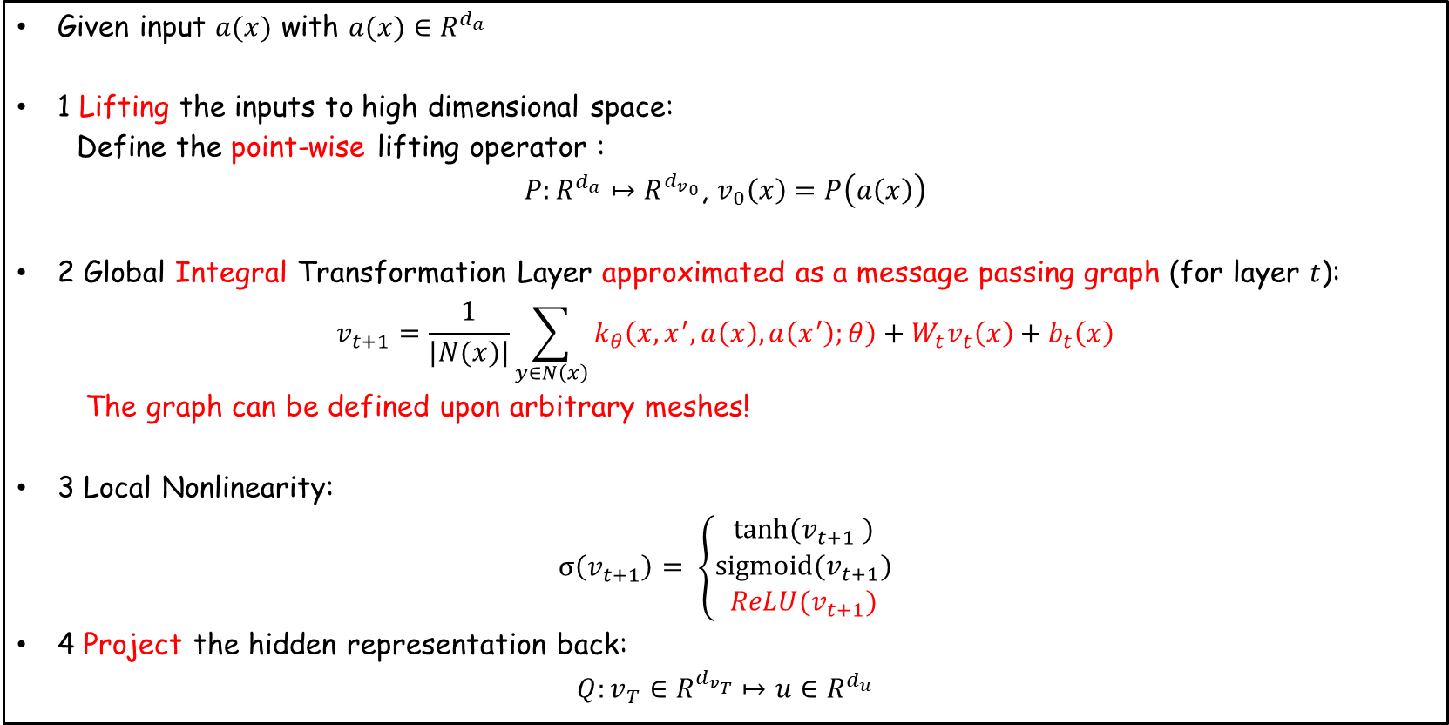
Graph Kernel Neural Operator
A direct extension of classical neural operator
Given input $a(x)$ with $a(x)∈R^{d_{a}}$
1 Lifting the inputs to high dimensional space:
Define the point-wise lifting operator :
$P:R^{d_{a}}↦R^{{d_{v}}_{0}}$, $v_{0}\left(x\right)=P\left(a\left(x\right)\right)$
2 Global Integral Transformation Layer approximated as a message passing graph (for layer $t$):
$$v_{t+1}=\frac{1}{|N(x)|}\sum_{y∈N\left(x\right)}{k_{θ}\left(x,x^{′},a\left(x\right),a\left(x^{′}\right);θ\right)}+W_{t}v_{t}\left(x\right)+b_{t}\left(x\right)$$
The graph can be defined upon arbitrary meshes!
3 Local Nonlinearity:
$$σ\left(v_{t+1}\right)= \left\{\begin{aligned}tanh⁡(v_{t+1} ) \\ sigmoid(v_{t+1}) \\ ReLU(v_{t+1})\end{aligned}\right.$$
4 Project the hidden representation back:
$$Q:v_{T}∈R^{d_{v_{T}}}↦{u∈R}^{d_{u}}$$

Slide 25
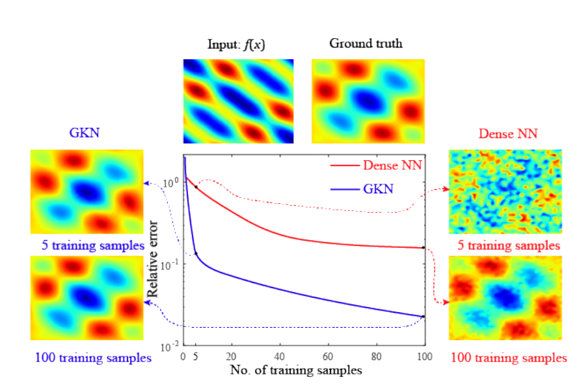
Graph Kernel Neural Operator
Learning the 2D Poisson’s equation

Slide 26
Summary
Neural network architecture
Key idea: A neural network layer is made of a global linear transform, with a local nonlinearity. Deep neural network can be built by composition – recursively applying this global-local operator.
One can be creative under this framework, and add relevant physics when needed.
Can you think of your own architecture?

